Slide 1
Masks
Secret Identities

Slide 2
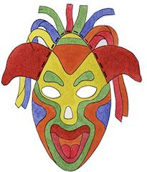
Does the way you look on the outside show who you really are on the inside?
A mask usually hides who you are, but what if a mask could show your true self?
WHAT IS A MASK?
WHY IS IMPORTANT TO LEARN ABOUT MASKS ?

Slide 3
Who are you?
What makes you different from others?
If you could show who really are inside with a mask:
What would you choose to represent yourself in a mask? (ie an animal, an object etc.)
Why would you choose this?

Slide 4
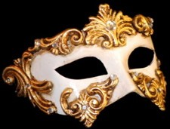
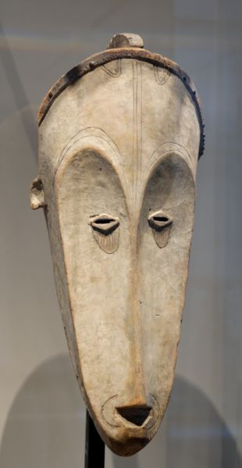
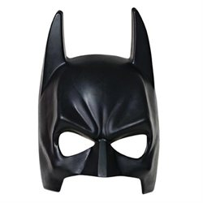
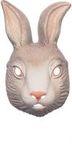
People all over make masks:
Masks have a long history in our culture -- in social and religious celebrations and in theater performances.

Slide 5
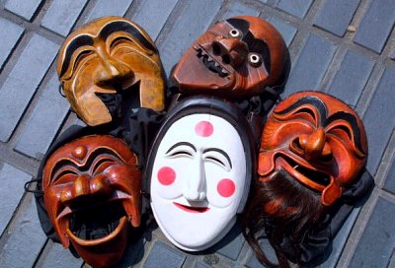
Asian Masks: show emotion

Slide 6
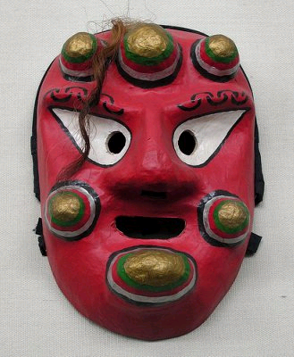
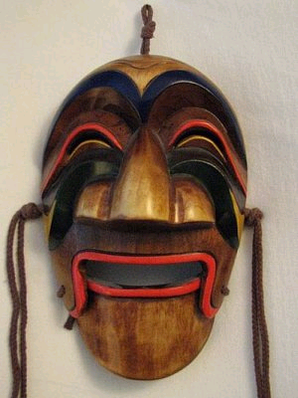
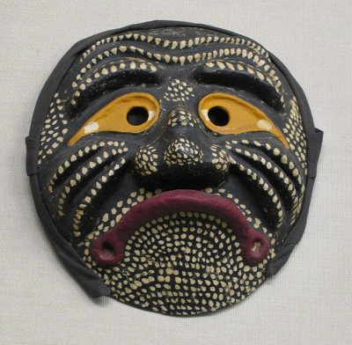
ANALYZE

Slide 7
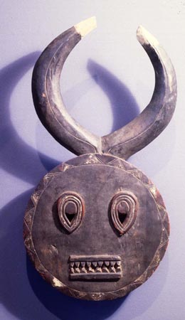
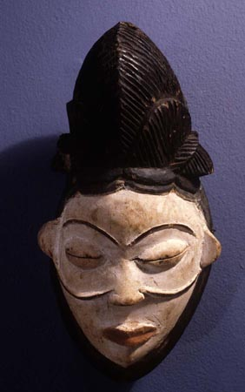
African Masks: show beliefs

Slide 8
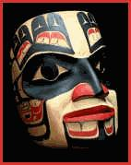
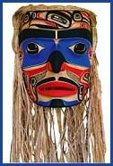
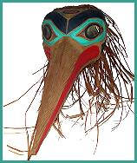
Native American Masks: show traditions of culture.

Slide 9
Answer these Questions
What is a mask?
What can masks tell us about the people who make them?
Can you think of another instance, other than the ones I have just explained, when we might wear a mask?
Why do people adorn(decorating) masks?
If you could pretend to be someone or something different for one day, what type of mask would you choose to wear to alter your identity?
Do you think it is a good thing to wear a mask once in a while to alter our identities? Why?
What is your ideal mask?.........................

Slide 10
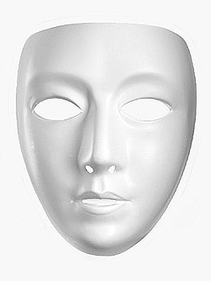
Add color and symbols

Slide 11
Complete
Draw, sketch and answer the questions on your graphic organizer.
Looking at your answers in your sketchbook, and find notes for your sketchbook.
1 .Rewrite them here ________________________________________________________________________PT…..
2. Brainstorming ideas (words or sentences) ________________________________________________________________________PT……
3. Colors (list the colors you plan to use for your final mask)________________________PT………..
4. Symbols, shapes, etc. ( list the special details) ________________________________ PT…..
5. Do you add 3D horns, feathers or spikes or other?_____________________________ PT……
6. Title of your mask that represent you _____________________________________ PT……
7 Where did you find your ideas - Write the internet page or author. Write the Citation
_______________________________________________________________________________________________________________________________________________________________PT……..
8. Read (Refer to the Mask Rubric for the scores and points) Review the Rubric in this packet to check your work.
9. Discuss your choices with your peers. Write what they say about your project ___________________________________________________________________________PT

Slide 12
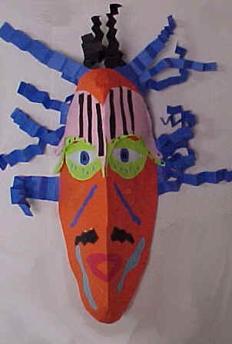
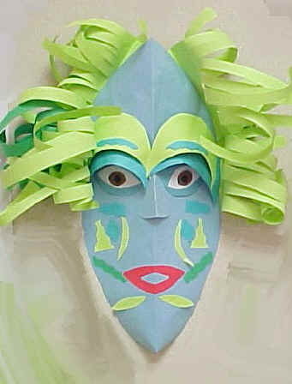
Now it’s your turn!

Slide 13
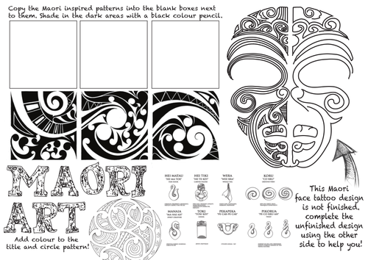
Complete the MAORI Mask

Slide 14
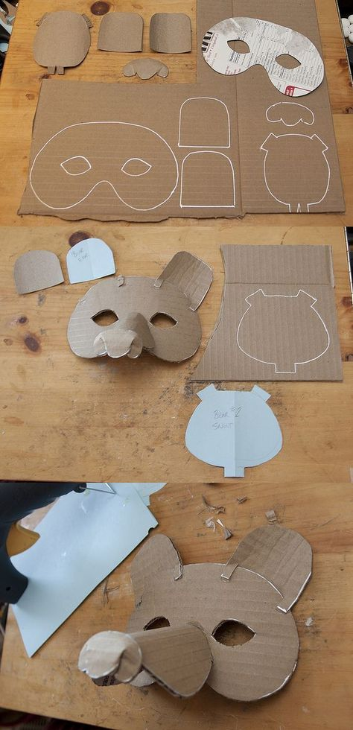
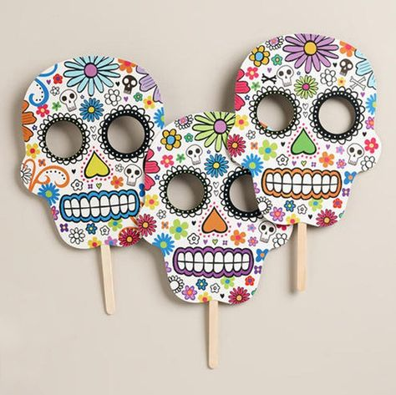
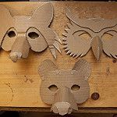
Cardboards Mask

Slide 15

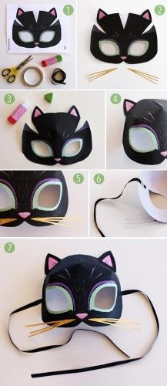
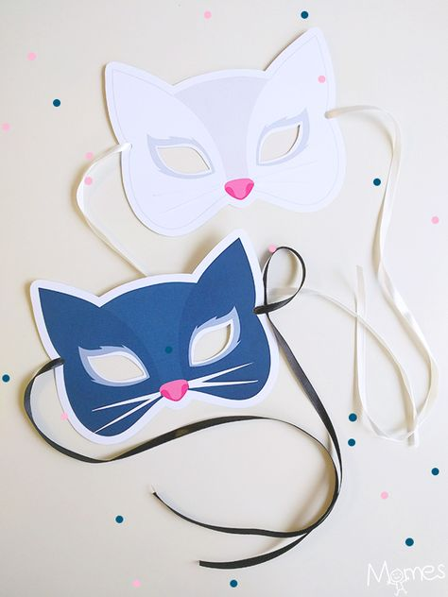
Paper Mask

Slide 16
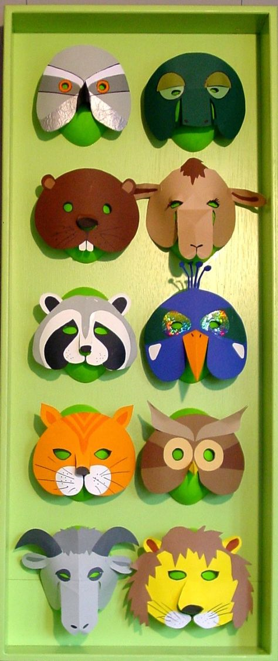
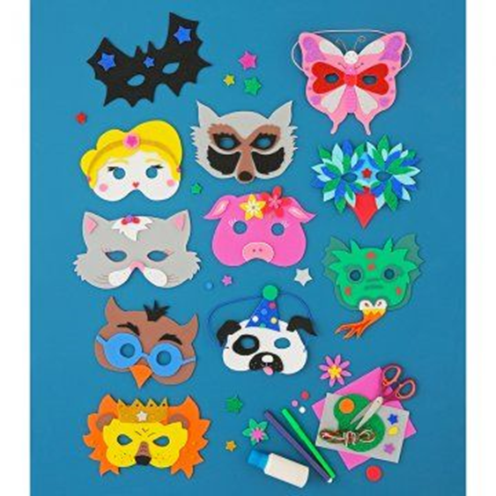

Slide 17
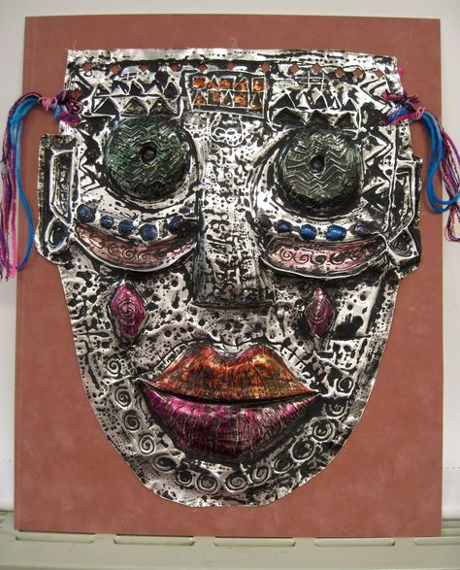
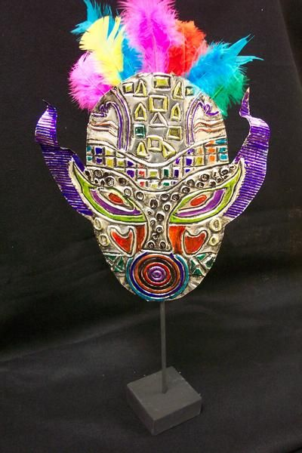
Foil aluminum Mask

Slide 18
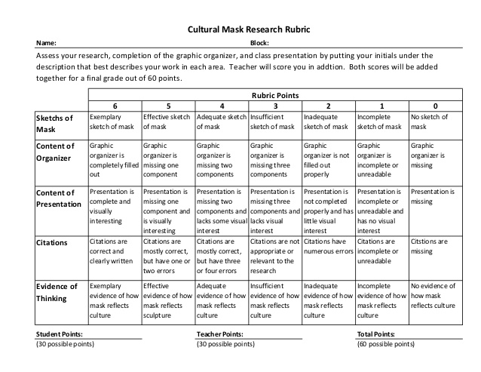
RUBRIC

Slide 19
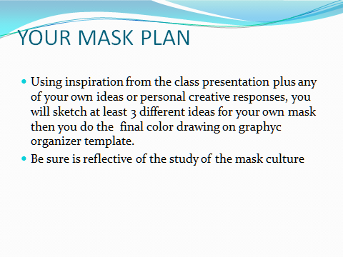
Circle and choose one of these level for your mask. Write more information on the line.
A - (EASY Level) Paper Mask - Drawing and painting your mask on paper……………………………………………..
B - (Medium Abilities of exploration) Do you like to use paper Mache?.........................................
C - Extension : (Difficult High Level Advanced)Do you want to explore different technique?...........
Standards : The student creates and communicates a range of subject matter, symbols, and ideas using knowledge of structures and functions of visual arts. - The student understands the visual arts in relation to history and culture.

